Slide 1
Gun Violence
Gun Violence - Team 3
Team Members:
Sarah Bonna (Team Lead),
Brian Mahabir,
Shivangi,
Showndarya Madhavan

Slide 2
Gun Violence
Project motivation:
Recent uptick in gun possession among youth in Boston's District 4
Need to understand the drivers of gun violence in the district and the city as a whole.
Inform policies that can improve the district and reduce the incidence of gun violence.

Slide 3
Gun Violence
Project Goal
To understand the drivers of gun violence in Boston's District 4 and the city as a whole, with a focus on identifying the variables associated with increases or decreases in gun violence.

Slide 4
Gun Violence
Project Background
To understand the project, it would be helpful to have knowledge of the factors that contribute to gun violence, such as poverty, access to firearms, mental health, and social dynamics.
Familiarity with the existing programs designed to address gun violence, their effectiveness, and their limitations would also be useful.

Slide 5
Gun Violence
Progress so far:
Continued to look for trends by segmenting data with different parameters
Datasets used:
City Council Dataset
Shots Fired
Shootings

Slide 6
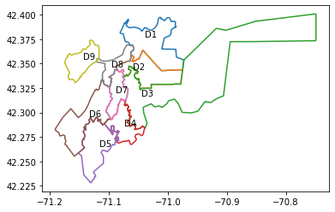
City council Shapefile dataset validation
Gun Violence
This plot ensures our group has the appropriate distinct bounded shapes, with the correct labels for checking the city council dataset shapefile

Slide 7
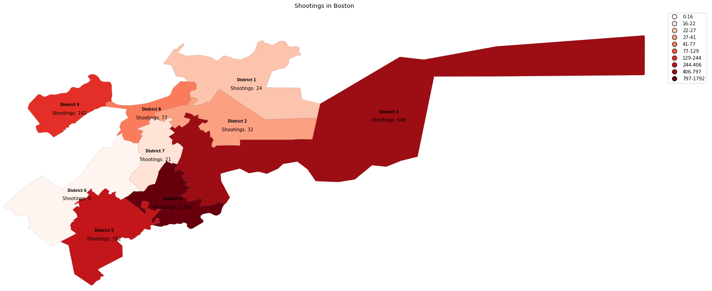
District wise intensity of gun violence w.r.t incidents count
Gun Violence
This plot demonstrates the stark difference in the intensity of gun violence incidents in District 4, which is more than twice, compared to the second most affected district

Slide 8
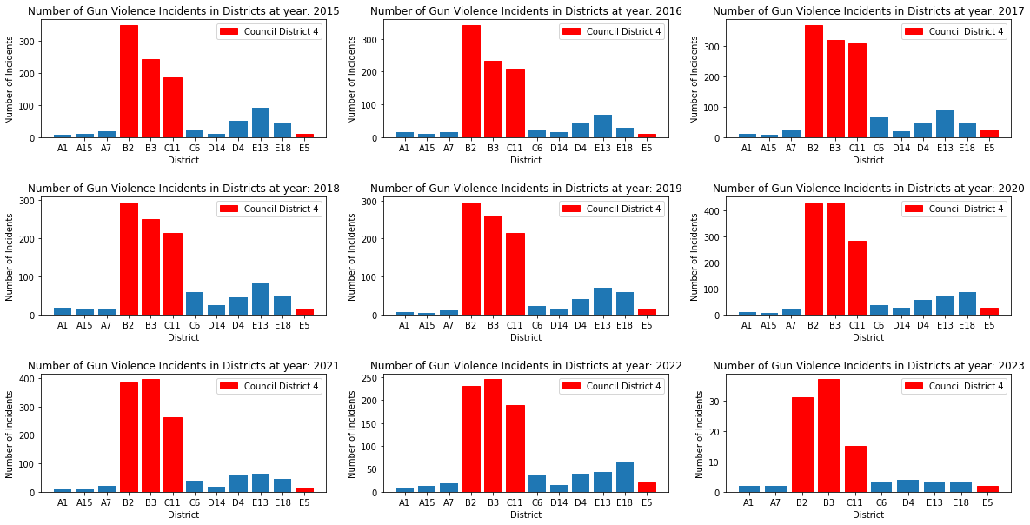
Rate of Gun Violence Incidents for Districts per Year
Gun Violence
For every year the trend of gun violence for each police district is fairly unchanging. This showcases that gun violence is not inherently dependent on the timeframe

Slide 9
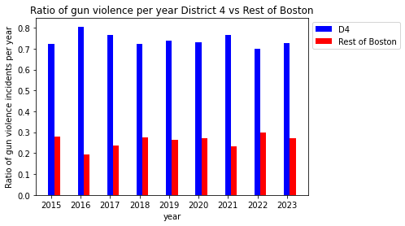
Ratio of Gun Violence in D4 vs Rest of Boston per year
Gun Violence
District 4 has the highest ratio of gun violence every single year from 2015 to 2023, slightly more than twice to rest of Boston
Highest ratio of gun violence in 2016 - 80% of gun violence in District 4
In 2023 - 70% of gun violence so far in District 4.

Slide 10
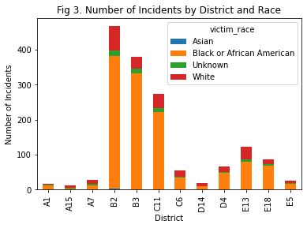
Number of Incidents by District and Race
Gun Violence
Black or African American residents are disproportionately affected by shooting incidents.
Unknown ethnicity victims are present in relatively high numbers - need improved reporting and data collection methods.
Incidents involving Asian victims are almost negligible.

Slide 11
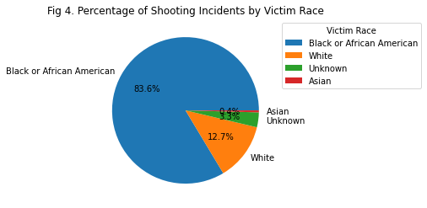
Percentage of Shooting Incidents by Victim Race
Gun Violence
Black or African American residents in the D4 district are disproportionately affected by shooting incidents.
Further analysis and investigation needed to understand the underlying reasons for this disparity to develop effective strategies for reducing gun violence in the area.

Slide 12
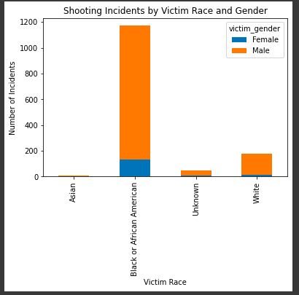
Shooting Incidents by Victim's Race and Gender
Gun Violence
Black Men are targeted the most.
Victim count of White Men are low compared to Black Men.

Slide 13
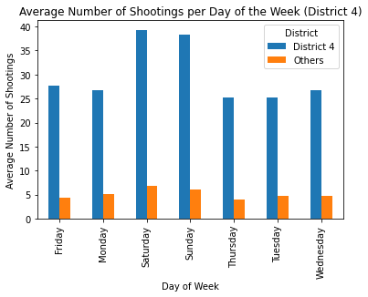
Average number of shootings per day of the week vs district (across the years)
Gun Violence
Avg # of shootings in District 4 is remarkably higher than all other districts combined
Higher avg # of shootings over the weekend (Saturday, Sundays)

Slide 14
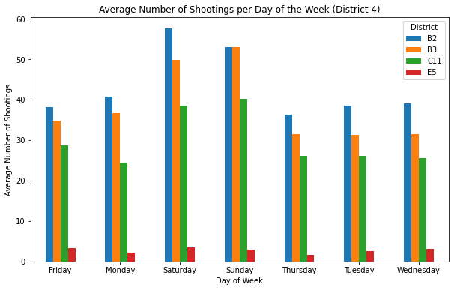
Average number of shootings per day of the week vs district (across the years)
Gun Violence
Out of the 4 police districts constituting District 4, the avg # of shootings in District B2 is the highest
Higher avg # of shootings over the weekend (Saturday, Sundays)

Slide 15
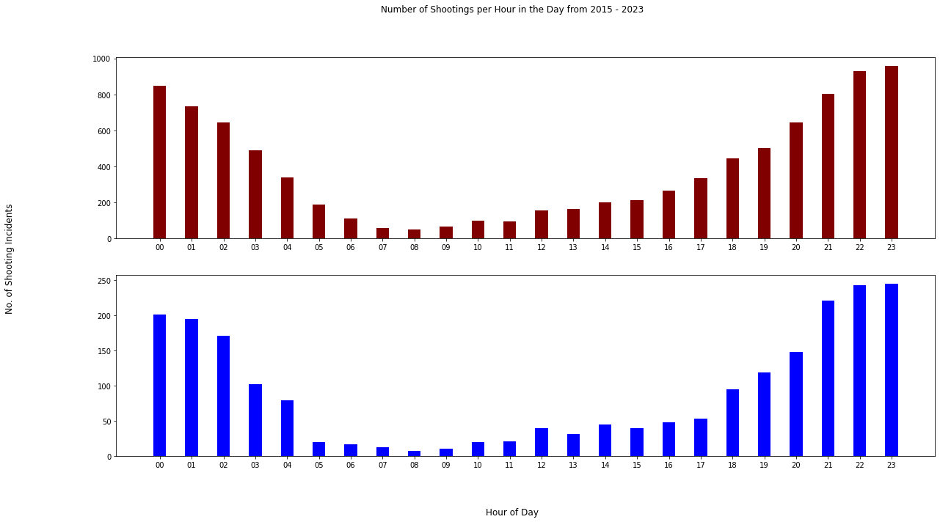
Shooting incidents Segmented by Hours
Gun Violence
It's more dangerous in the night than the day
Council District 4 trend mimic the rest of Boston
Notes:
Key Findings from this graph:
District 4 has the highest ratio of gun violence every single year from 2015 to 2023.
The disparity in the ratio of gun violence between District 4 and the rest of Boston ranges from slightly more than twice to slightly more than 4 times.
The highest ratio of gun violence occurred in 2016, with 80% of gun violence in that year occurring in District 4.
In 2023 alone, 70% of gun violence thus far occurred in District 4.

Slide 16
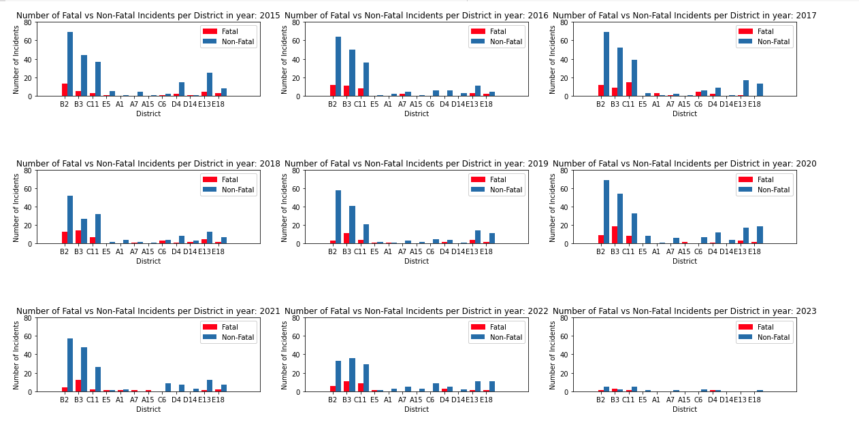
Number of Fatal vs Non-Fatal Incidents per District per Year
Gun Violence
The graph above shows a comparison of how fatal vs non-fatal shooting incidents in the various districts have changed over the years, given the y-axis is the same (max. 80).

Slide 17
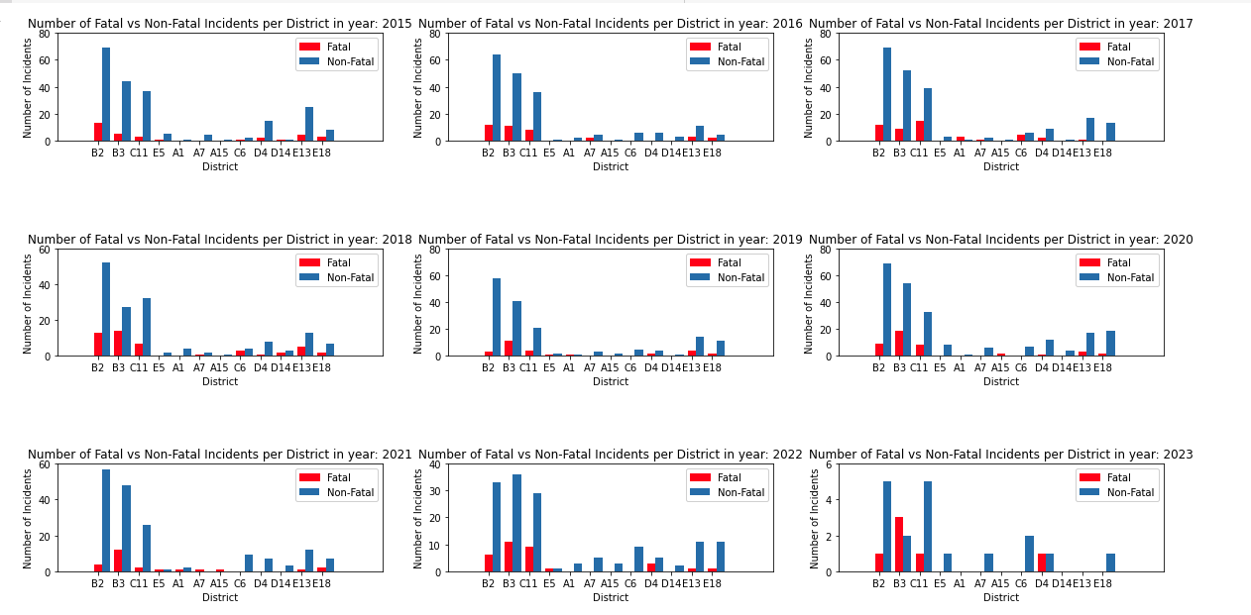
Number of Fatal vs Non-Fatal Incidents per District per Year
Gun Violence
B2 has the highest number of non-fatal shooting incidents every year, except in 2022 and 2023.
Police district B3, has the highest number of fatal shooting incidents every year from 2018 to 2023.

Slide 18
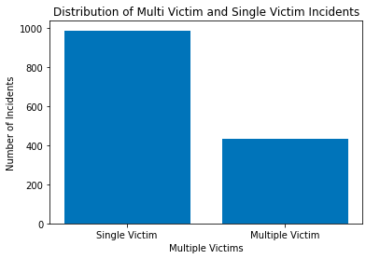
Multiple Victims vs Single Victims
Gun Violence
The number of single victims is almost double that of multiple victims
Targeted attacks outnumber mass shootings / family related attacks
Notes:
Bri

Slide 19
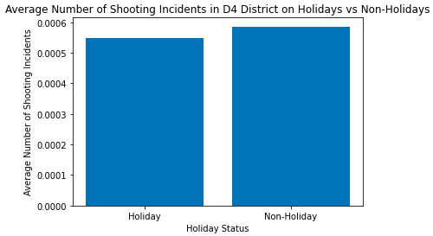
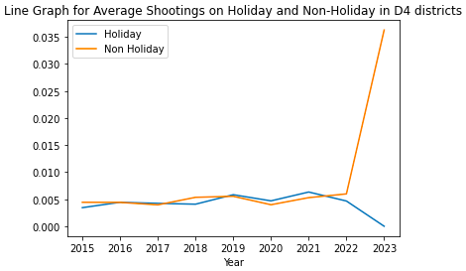
Average Number of Shooting Incidents on Holidays vs Non-Holidays
Gun Violence
We can see that number of incidents on Holidays and Non-Holidays are almost similar.
Notes:
Bri spike isn't accurate because we don't have enough data yet.

Slide 20
Summary
Gun Violence
Challenges
Preprocessing the data was hard
Lack of data regarding the motive of each crime
Limitations & Assumptions
Wish we had better shape files to map boston city council districts to police districts
We had to assume slightly about D4’s location
Next steps
Use different datasets that were not given to give better insights to the trends we discovered
Steps to goal
Planning to use data on green spaces to see if there is any relationship between gun violence and the amount of green spaces in the various districts
Notes:
Bri

Slide 21
Project Extension Proposal
Rationale
To highlight potential important environmental trends which can pave the way for approvals for redesigning areas of Boston
Hypothesis
Greener environments have less violence than desolate urban settings.
More gun violence incidents closer to community centers.
More details found here:
Extension Proposal

Slide 22
Questions?
Gun Violence

